Slide 1
Book Recommendation System
Motivation & Background
Content Based & Collaborative Based
Memory based & Model Based
Data Cleaning & Exploration
Machine Learning
Model Selection
Hyperparameter Tuning
Generating recommendations
Conclusions & Next Steps
Rochita Sundar
March’22

Slide 2
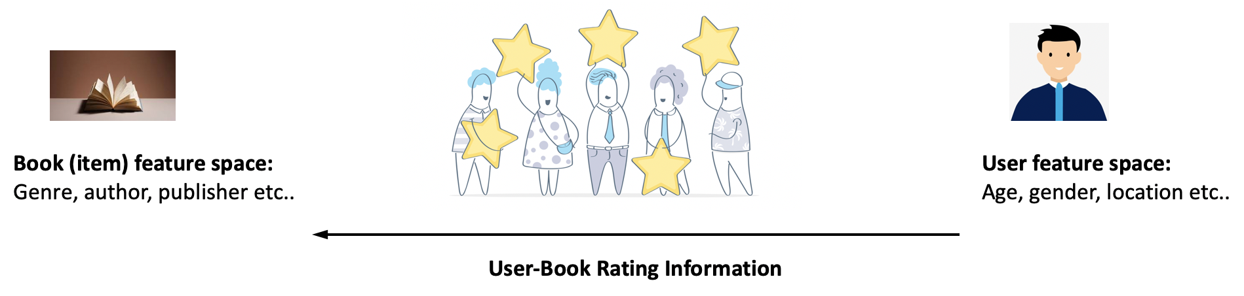
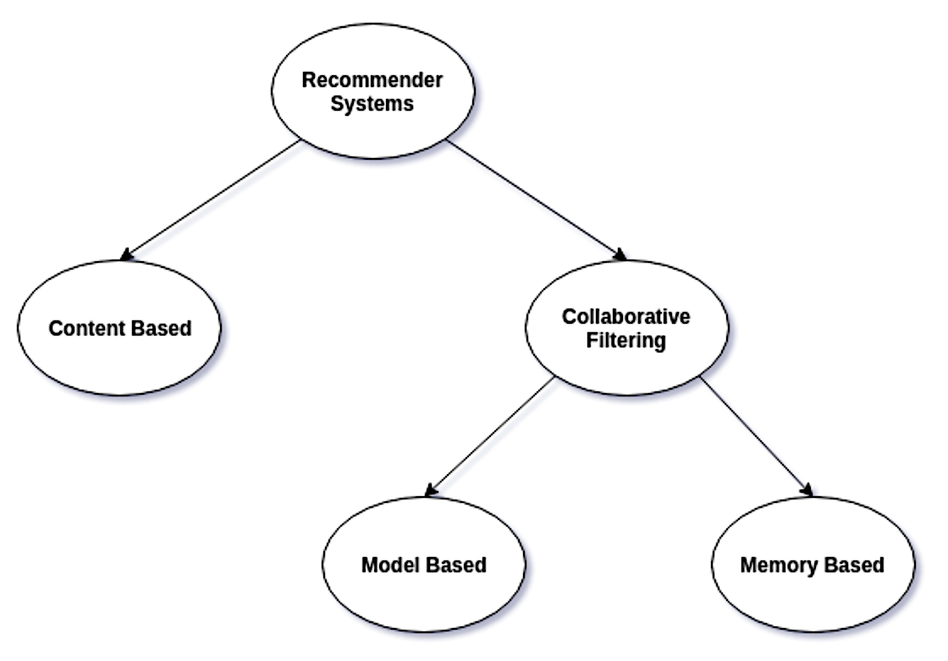
Recommendation Systems: One of the largest application areas of ML. Enable tailoring personalized content for users, thereby generating revenue for businesses
Content based recommendations based on user past likes & dislikes – System recommends items similar to items users have liked based on item feature space
Collaborative based recommendations – more robust & widely used. Disregards item & user feature space & solely based on how different users rate different items
- Memory based approach
- Model based approach

Slide 3
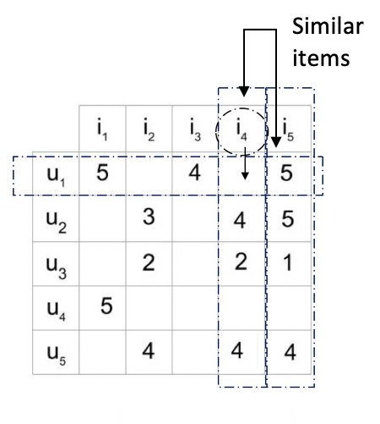
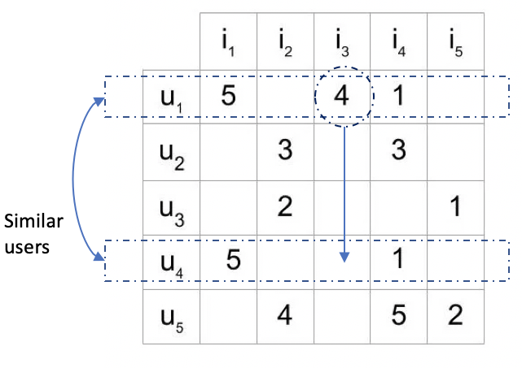
Memory based based Collaborative filtering
- e.g. KNN (K-Nearest Neighbors)
Utilizes entire user-item rating information to calculate similarity scores between users or items
In user based collaborative filtering, two user's are considered similar, if they rate items in a similar manner. An item is recommended to a user, if another user i.e., similar to the user in question has liked the item
In item based collaborative filtering, two item's are considered similar, if users rate them in a similar manner. An item is recommended to a user, that is similar to the items the user has rated in the past
*Making Recommendations More Effective Through Framings: Impacts of User- Versus Item-Based Framings on Recommendation Click-Throughs - Scientific Figure on ResearchGate. Available from: https://www.researchgate.net/figure/Illustration-of-the-definitions-of-user-based-and-item-based-framing_fig1_335781811 [accessed 4 Mar, 2022]
*https://realpython.com/build-recommendation-engine-collaborative-filtering/

Slide 4
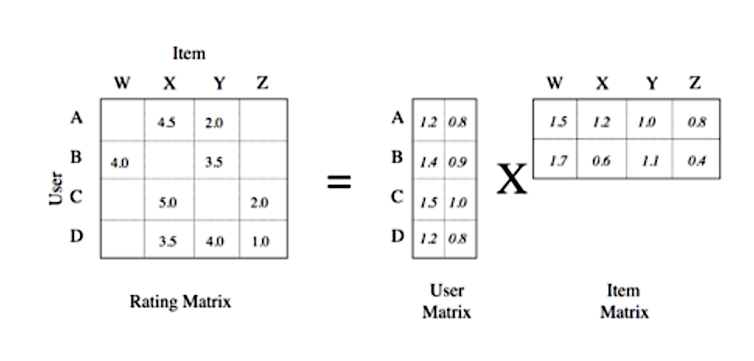
Model based based Collaborative filtering
- e.g. Singular Value Decomposition
Model based approach utilizes information from the dataset to build a model & the model (not the entire dataset) is thereafter used for making recommendations
For dimensionality reduction, the model optimizes certain latent features (hidden characteristics) that are able to map user item preferences
In the process, the model is able to predict an estimated rating for all user-item pair, where user has not yet rated an item
*Source: data-artisans.com

Slide 5
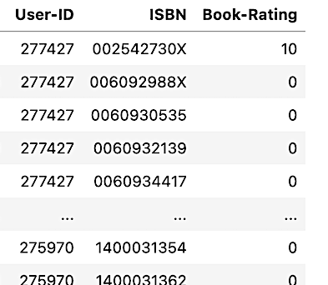
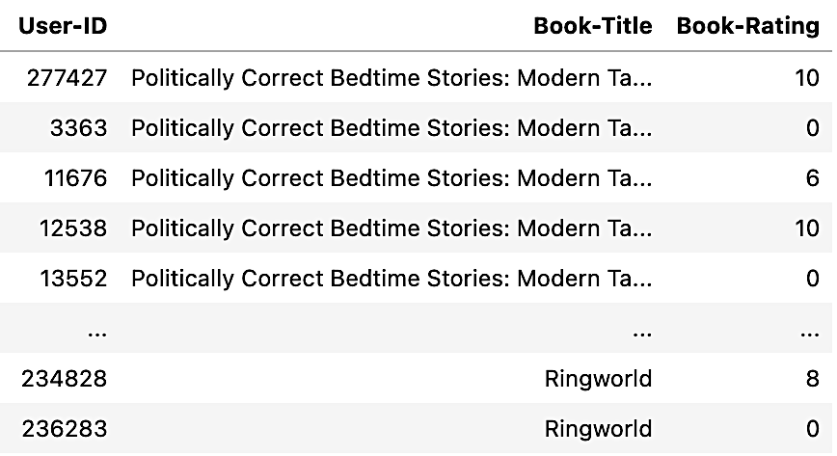
Data exploration & cleaning
'Book-Crossing dataset' collected by Cai-Nicolas Ziegler
(http://www2.informatik.uni-freiburg.de/~cziegler/BX/)
Check for missing values
& duplicate entries
Drop them from the
database
merge rating table with book table using ‘ISBN’ to include book titles instead of ‘ISBN’ for interpretability
– 1,149,780 records

Slide 6
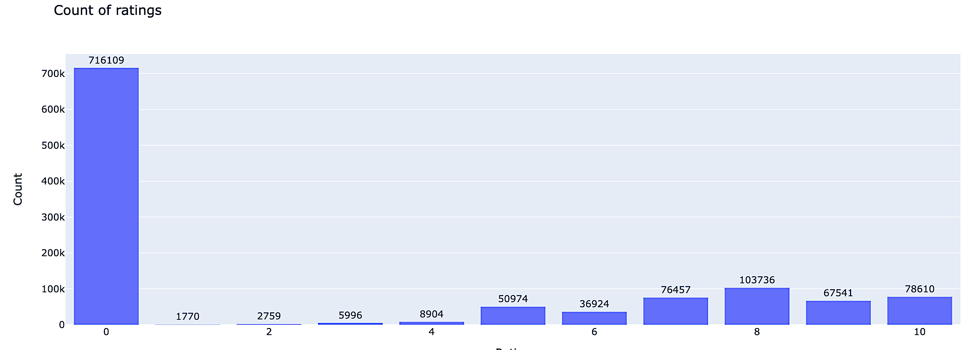
Exploratory data analysis
Ratings are of two types, an implicit rating & explicit rating. An implicit rating is based on tracking user interaction with an item such as a user clicking on an item '0'. An explicit rating is when a user explicitly rates an item, i.e., b/w '1-10'
Majority of ratings are implicit i.e., rating '0'
Rating of '8' has the highest rating count among explicit ratings '1-10'

Slide 7
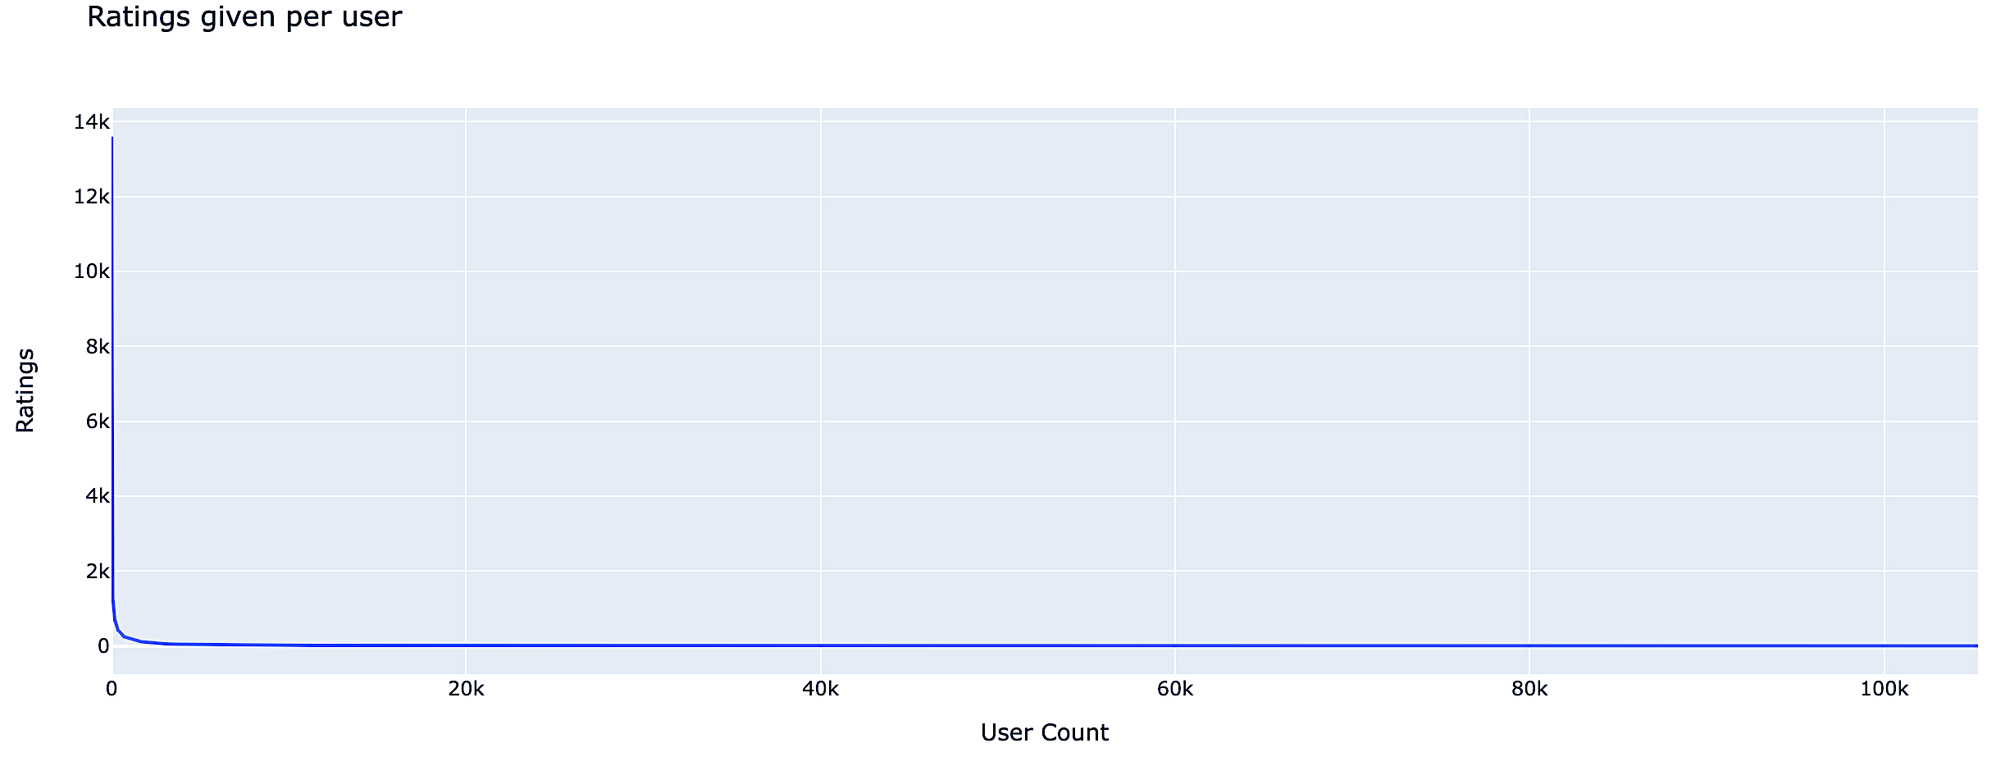
There is inherent bias in the dataset. There are few users who rate a lot & several users that provide very few ratings. One user has provided 13K+ ratings, only ~700 users (out of 100K+ users) have provided over 250 ratings
Filter dataset to only include users that have provided > 250 ratings

Slide 8
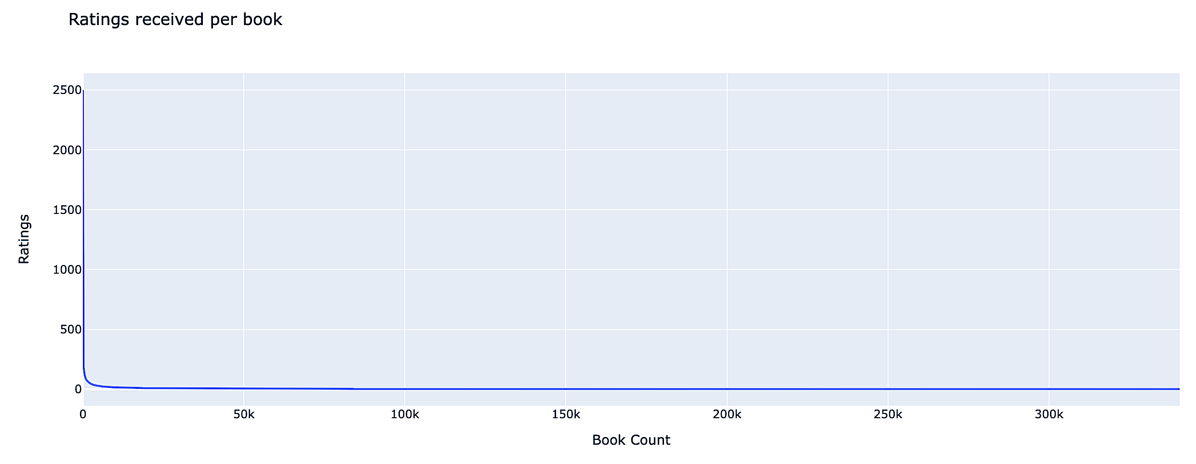
A similar bias is observed. There are a few books that have received many ratings and several books that have received very few ratings. One book has received over 2500 ratings, only ~2100 books (out of 300K+ books) have received more than 50 ratings
Filter dataset to only include books that have received > 50 ratings

Slide 9
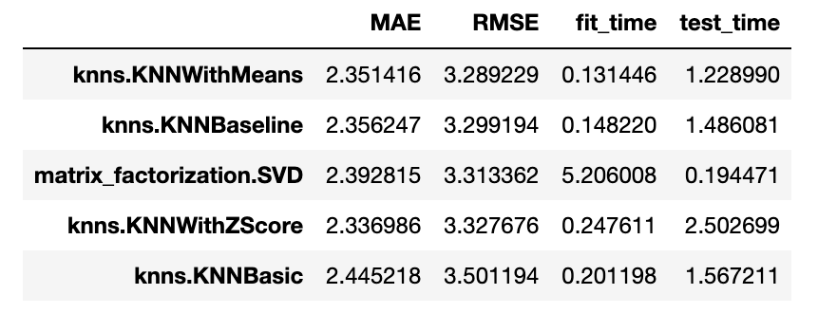
Machine Learning – Model Selection
After data cleaning, there were 78,782 records left
686 unique users who have rated > 250 books each
1913 unique book titles that have received > 50 ratings each
Use Python’s surprise library algorithms for building recommendations
5 fold cross validation model performance on training set (with default model parameters):
KNNWithMeans has the least RMSE (root mean square error) among KNN algorithms
The model fit_time is the maximum for SVD but the model test_time is the least

Slide 10
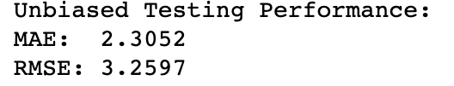
Machine Learning – Hyperparameter tuning with GridSearchCV
KNNWithMeans Model Parameters:
Name: distance measure, e.g., MSD or cosine
Min_support refers to minimum number of items to consider for calculating similarity between users in user based collaborative filtering (or vice versa)
User_based: True or False (item based)
MAE: {'sim_options': {'name': 'cosine', 'min_support': 3, 'user_based': False}} ; MAE: 2.35610
RMSE: {'sim_options': {'name': ‘msd', 'min_support': 5, 'user_based': True}} ; RMSE: 3.29518
Model generalizes well!

Slide 11
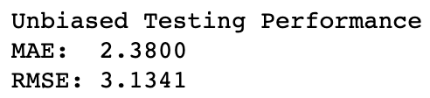
Machine Learning – Hyperparameter tuning with GridSearchCV
SVD Model Parameters:
n_factors refers to number of latent factors for dimensionality reduction
n_epochs, lr_all, reg_all refers to number of iterations, learning rate & regularization rate of SGD (stochastic gradient descent) procedure utilized by SVD for matrix factorization
MAE: {'n_factors’: 10, 'n_epochs': 20, 'lr_all': 0.005, 'reg_all': 0.2} ; MAE: 2.37744
RMSE: {'n_factors’: 50, 'n_epochs': 10, 'lr_all': 0.005, 'reg_all': 0.2} ; RMSE: 3.15542
Model generalizes well!

Slide 12
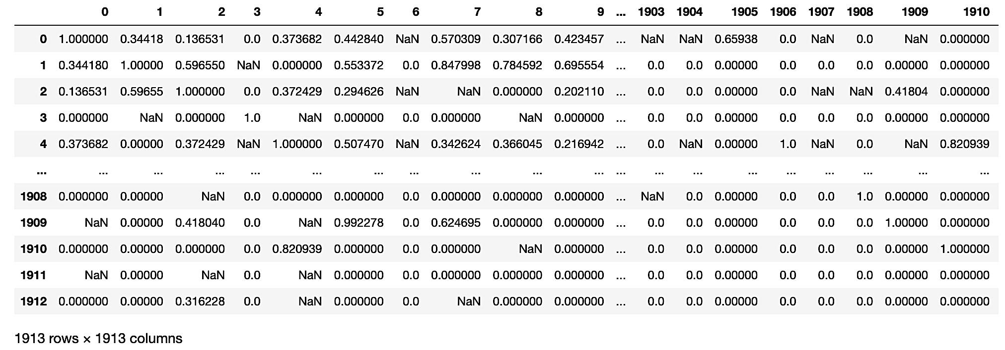
Building Recommendations
KNNWithMeans
An item similarity matrix is computed between 1913 unique books
Using cosine distance measure
Using at least how 3 or more users have rated the books
The similarity score is between 0 & 1
A custom function is written to generate as many recommendations as a user wants based on their “top K” rated books:
User rating for top ”K’ rated books is multiplied with similarity scores with other books using the similarity matrix. The ratings are added & divided by sum of similarities to calculate weighted rating for a book the user has not yet read

Slide 13
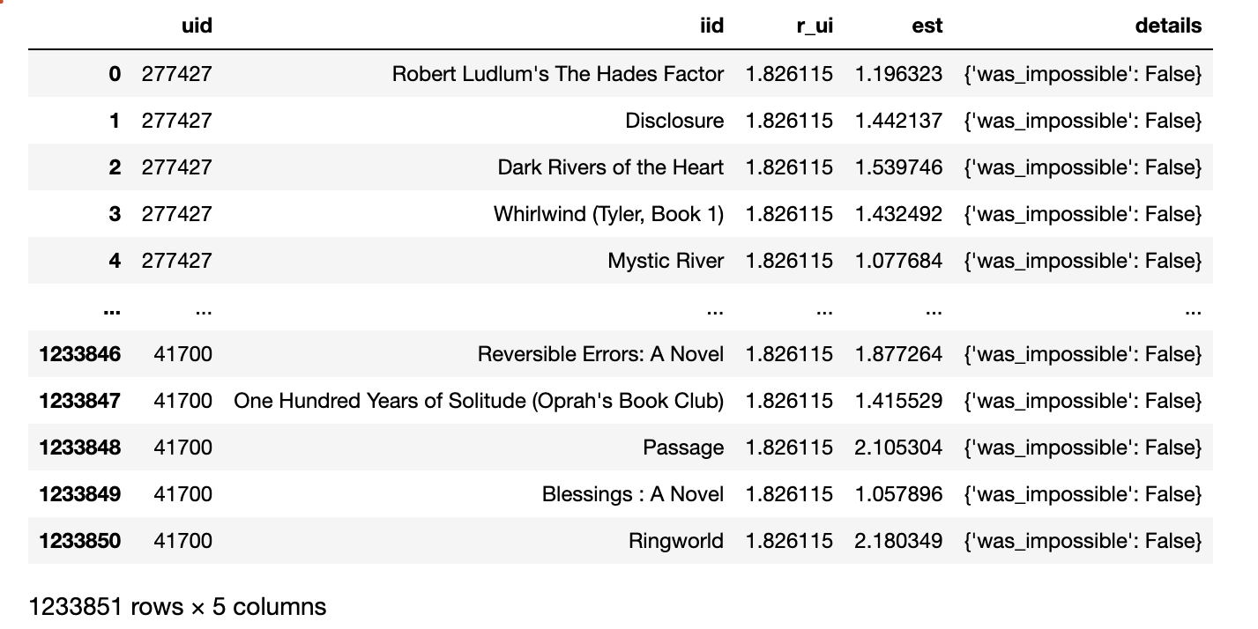
Building Recommendations
SVD
SVD uses the available information of users rating some books to build a user matrix & item matrix with some latent features (n=50)
This process by default enables a predicting a rating for all combinations of users & books where a user has not yet rated a book
A custom function is written to recommend items with high estimated ratings (as many as the user would like)

Slide 14
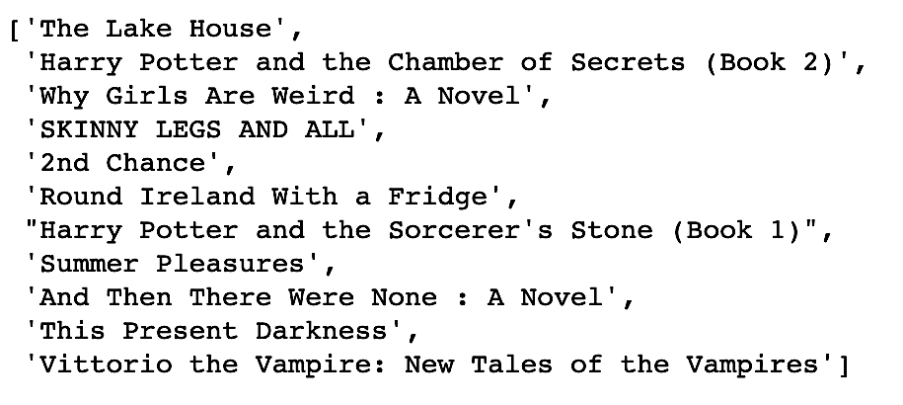
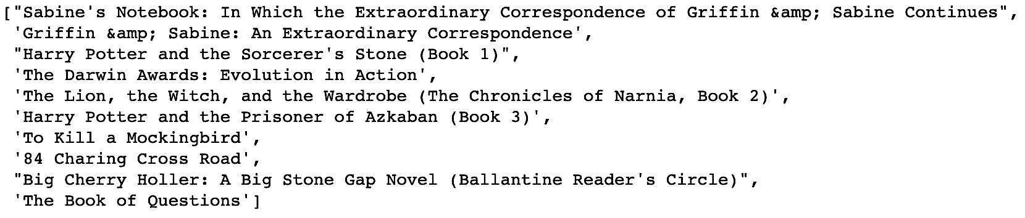
Comparing Recommendations
The outputs (above & below) shows the top 10 recommendations for the user 13552 using KNNWithMeans & SVD
Both algorithms recommended instances of Harry Potter novels for user 13552. Additionally, the recommended books seem to be a similar genre lending confidence in interpretability of recommendations

Slide 15
Conclusions & Next Steps
We have successfully implemented a memory based as well as method based collaborative filtering approach to make recommendations in this project
In instances with a new user or new item where little is known of the rating preference, collaborative filtering may not be the method of choice for generating recommendations. Content based filtering methods may be more appropriate. Often, a hybrid approach is taken for building real time recommendations using multiple different approaches in industry! The project can be extended to build hybrid recommendation systems in the future

